Slide 1
Some Thoughts About How to Safely Accommodate People With Disabilities in the Laboratory
Presented by Debbie M. Decker, ACS Fellow, CCHO
Retired Laboratory Safety Manager
Spring 2022 ACS National Meeting

Slide 2
Introduction
People with disabilities and inclusion
Disabilities may be obvious - use of a wheelchair or service animal
Disabilities may be subtle – metabolic or seizure disorders or processing challenges
Case Studies for your consideration
Notes:
If we're serious about diversity and inclusion, we must also be open to accommodating people with disabilities in the laboratory. This presentation will offer some thoughts, insights, ideas and resources to help institutions and individuals encourage and support people who might need workplace adaptations or who have a service animal.

Slide 3
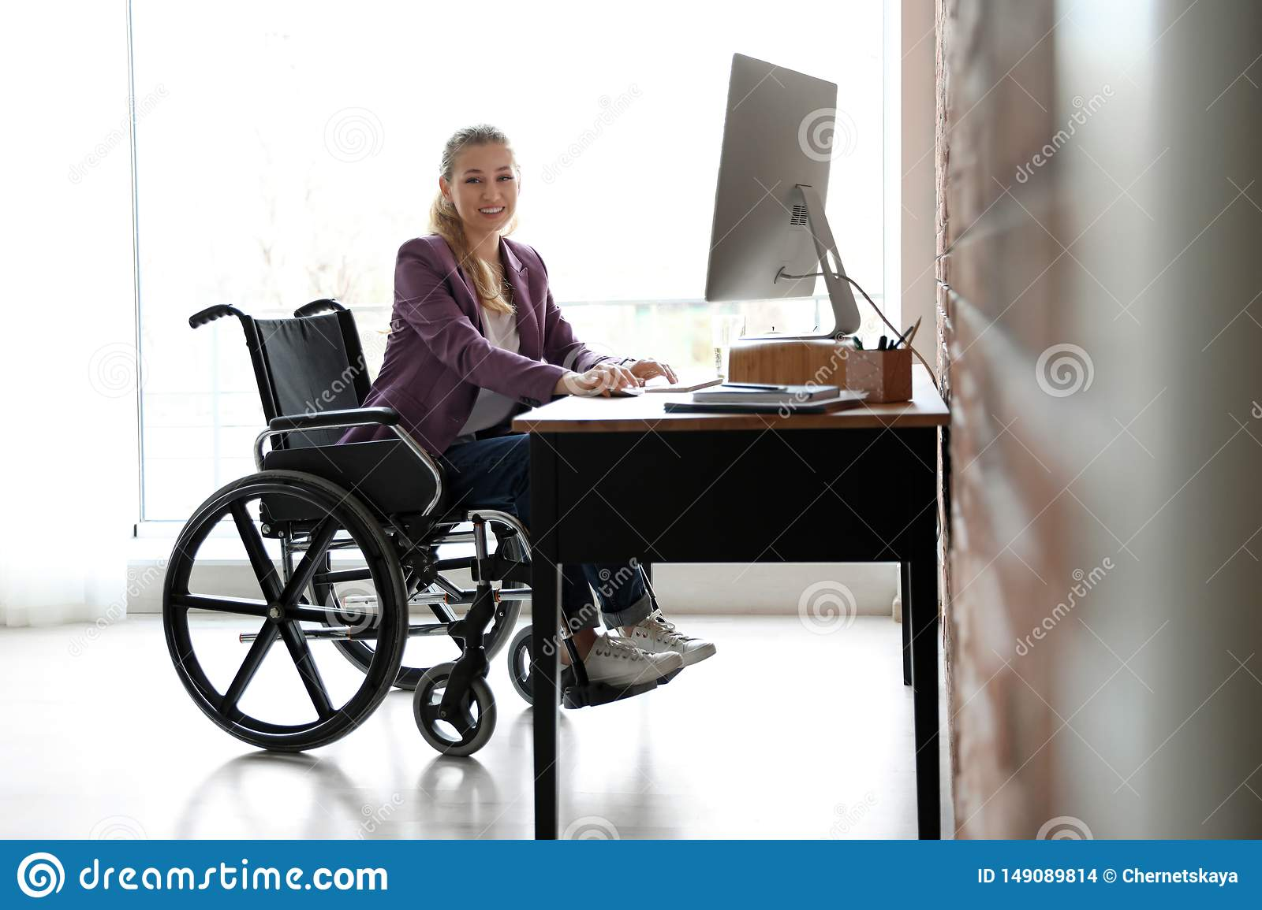
Case Study #1: Workstation Follies
I don’t think “accessible” means what you think it means.
Notes:
Early in my career with UC Davis, I worked with the Veterinary School on their safety program. A researcher whose research focused on comparative feline genetics had hired a post-doc to work in the huge datasets the research group generated. The post doc was a wheelchair user and, unbeknownst to the post-doc, the department had spent a considerable amount of money to create a specialized “accessible” workstation for her. When the post-doc arrived, her wheelchair wouldn’t fit in the “accessible” workstation and a standard workstation was just fine for her. The department had to go to significant expense to rip out the “accessible” workstation and replace it with a standard workstation. When I discussed the situation with department leadership, they told me that they couldn’t ask the person anything about their needs for accommodation because it was “illegal” to ask. You will note in this stock image the person can’t comfortably access the workstation without leaning forward in their chair and the arms of the chair won’t allow close in access to the keyboard and monitor. This aspect may not be possible or may cause injury for some people. The workstation needs to fit the person.

Slide 4
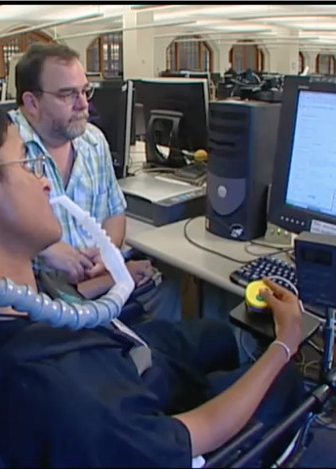
Please Ask!
Develop essential job functions to help guide the conversation
Ask neutral questions, related to the essential job functions
University of Washington - Disabilities, Opportunities, Internetworking, and Technology (DOIT) Center (https://www.washington.edu/doit/)
Notes:
This is a common misconception – that as a supervisor, administrator or colleague of a person with a disability you can’t ask that person about what accommodations they might need. Of course, you can ask! And you must ask. You need to ask to be able to understand how to help this person be safe and successful in the workplace. If the vet school department had just called up and asked the new post-doc what she needed for a workstation, they wouldn’t have had to replace what wasn’t going to work. They didn’t even need to mention the post-doc’s wheelchair use – just the ask about needs for a workstation or other equipment. Just a neutral query from the department about office/chair/phone needs would have been fine. Having a good descriptor of essential job functions can guide the conversation. This image is from the University of Washington, Working Together video. The Disabilities, Opportunities, Internetworking, and Technology Center has a wealth of creative information about accommodations and accessible solutions.

Slide 5
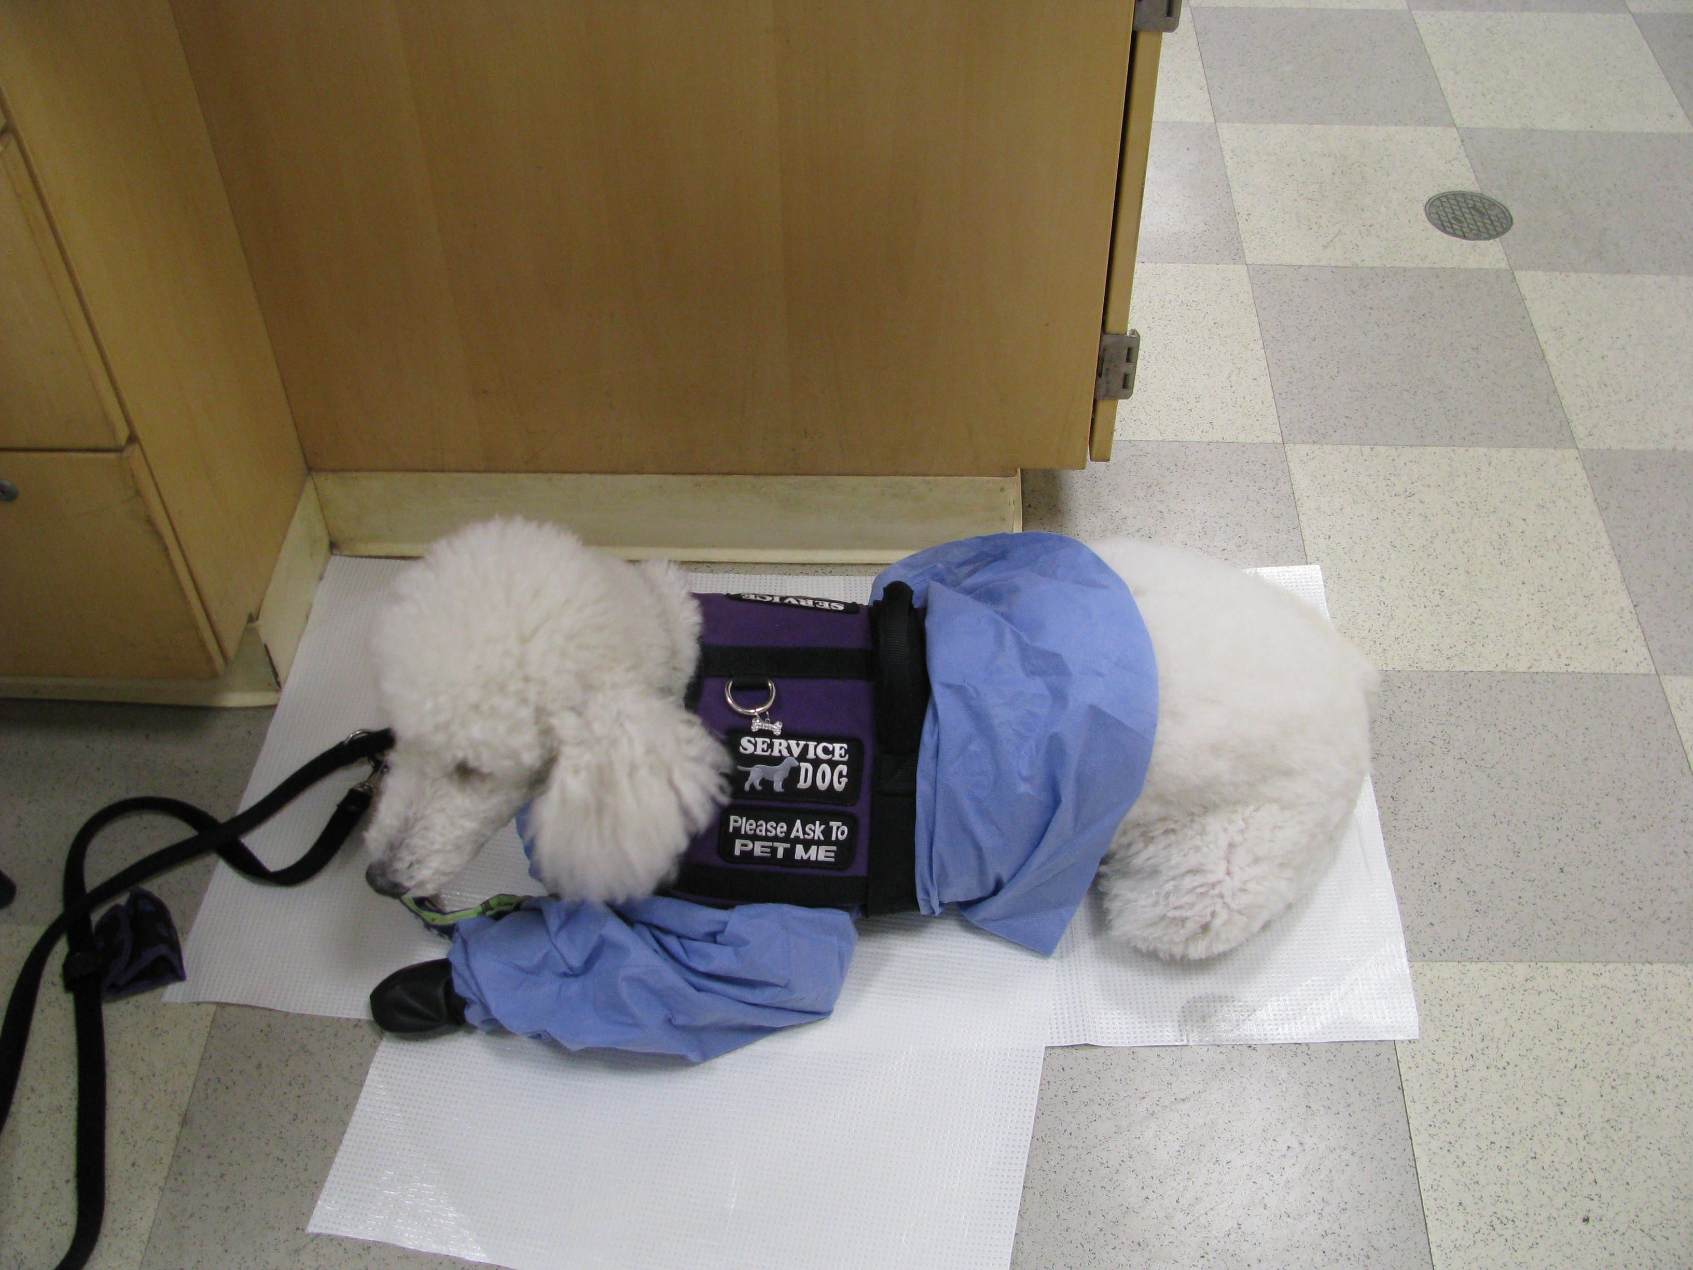
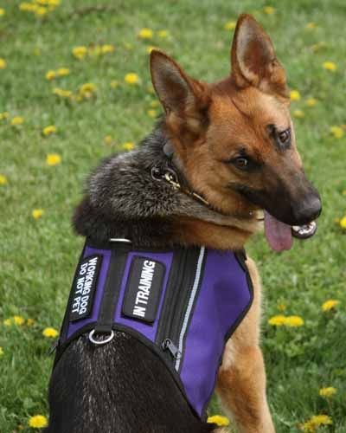
Case Study #2
Shannyn and Memphis
  These are the questions you can ask about a service dog:
  (1) is the dog a service animal required because of a disability, and
  (2) what work or task has the dog been trained to perform.
  You may not ask if the dog has training, what’s the nature of the disability, or ask for the dog to demonstrate their training.
Notes:
When I encountered my first student with a service dog, I quickly discovered I would need to develop some guidance and documentation for the department. The student, Shannyn, was willing to work with me to develop a behavior contract, (based on campus policy) for service dogs and a form to describe the student’s needs and the department agreements to support those needs. I also worked with my colleague, Sheila Kennedy (now retired) at UC San Diego, to develop this document. Sheila was helpful in making sure my language was inclusive and detailed enough to be helpful but didn’t stray into inappropriate territory of asking about medical information or justifying the need for accommodation. This is where essential functions comes in.
While I couldn’t ask Shannyn why she needed Memphis, she was delighted to talk about Memphis and to collaborate with me to develop guidelines for others. She offered a fair amount of information about Memphis’ training and what he did for her – how he alerted, what should staff do if Memphis alerts, etc. I have found that people will tell me additional, very helpful information, without my asking, if I just open the conversation. “Tell me about your dog.”

Slide 6
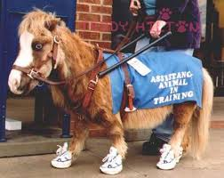
Legal Framework for Service Animals
Revised ADA requirements (ada.gov)
  Beginning on March 15, 2011, only dogs are recognized as service animals (updated to include miniature horses)
  Service animals are defined as dogs that are individually trained to do work or perform tasks for people with disabilities.
  Service animals may accompany people with disabilities in all areas where members of the public are allowed.
  Service animals must be harnessed, leashed, or tethered, unless these devices interfere with the service animal’s work or the individual’s disability prevents using these devices.
  A person with a disability cannot be asked to remove his service animal unless: (1) the dog is out of control and the handler does not take effective action to control it or (2) the dog is not housebroken
  In addition to the provisions about service dogs, the
  Department’s revised ADA regulations have a separate
  provision about miniature horses that have been individually
  trained to do work or perform tasks for people with disabilities
Notes:
The term “service animal” has regulatory meaning and only dogs and miniature horses are recognized as service animals. Emotional Support or Assistance animals – monkeys, cats, rats, reptiles, peacocks, chickens - are not recognized as service animals and not regarded as such under ADA. There is language in the Fair Housing Act that deals with assistance animals but not ADA. Legitimate service dogs, in particular, are carefully trained to not engage when approached by another dog, even if attacked. There are numerous cases where a service dog was attacked by someone’s pet, being passed off as an “assistance animal” and not properly trained to behave. It can end a service dog’s career, if they are unable to recover from the trauma of the attack.

Slide 7
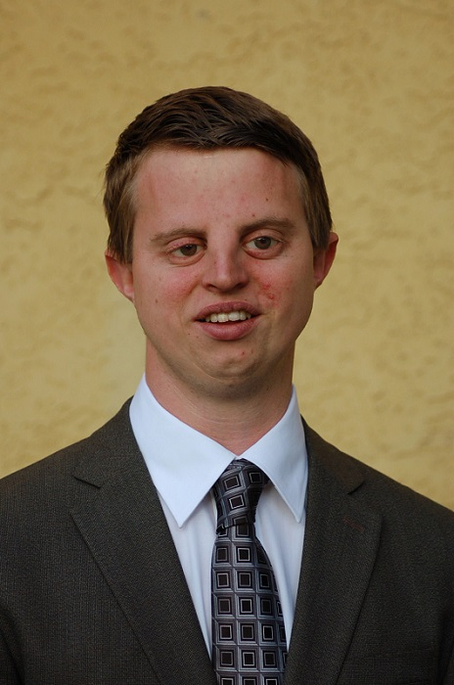
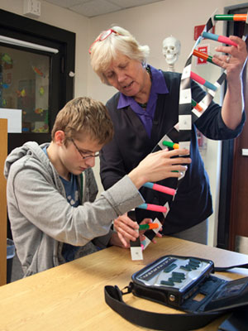
Case Study #3
Student Who is BVI (Blind/Visually Impaired)
www.hobywedler.com
Put your assumptions aside and listen – you will learn many things.
Notes:
I had the privilege of working with Hoby Wedler, who is blind and a PhD Chemistry graduate from UC Davis. Working with his PI, Hoby had developed a methodology to build 3D molecular models for students who are BVI. We also discussed in detail expectations of what a lab aide should do for a student who needs one. This discussion was very helpful as I continued to work with students who had disabilities and needed a lab aide. His perspective as a person who needed accommodations but who did not accept limitations was illuminating to me. Hoby has been wildly successful, taking his scientific knowledge and abilities as a blind person to create several companies, including a non-profit called Accessible Science.
Fast forward several years and I met with a student who told me he had a degenerative eye condition. His visual acuity was okay early in the day but as the day wore on and he tired, he became more and more visually impaired. Early in the quarter, he thought he might be able to manage lab without a lab aide. We had an honest conversation about his condition and how he felt about hiring a lab aide. He decided to try to not have a lab aide and for the first few weeks, seemed to manage. But as the quarter evolved and the workload increased, it became much more difficult for him to maintain the level of energy necessary to be able to see well enough to accomplish lab work. We met again and he decided to engage a lab aide. I was happy to find out at the end of the quarter that he’d been successful with his lab aide and was planning on continuing in chemistry.

Slide 8
Hints and Tips For A Successful Conversation
Create an atmosphere of trust and respect
Be as neutral as possible in your language
If they present with a service dog, ask them to tell you about their dog
Document the agreements you make with the person requesting accommodation
Notes:
Approach these conversations with a collaborative mindset. Create an atmosphere of trust and respect so that people with disabilities will come to you for advice and help. Realize that people with disabilities have clawed and fought their way to your institution. They are smart and capable, and they know what they need.
Be as neutral as possible in your language. Understand the physical requirements of the work the person will need to do and ask about their ability to accomplish those tasks. Will they need an accommodation to accomplish certain tasks? It could be as simple as a larger handle on a faucet or larger numbers in a readout.
If they present with a service dog, ask them to tell you about their dog. If you listen carefully, you’ll find out all the information you need to know about what work the dog does for their person. You can and must have behavior expectations for the service dog.
And it’s very important for you to document the agreements you make with the person requesting accommodation. You may have a disability services office that will work with people to accommodate additional time on exams or a certain type of venue to work in, etc. But most of these offices don’t have experience with laboratory work.

Slide 9
Closing Thoughts
People with disabilities have much to contribute
Approach conversations with:
  A listening heart
  A collaborative mindset
  A positive attitude
Notes:
People with disabilities have much to teach the able-bodied about tenacity, advocacy and creativity. And to contribute these same traits to the workplace. If we approach these conversations with a listening heart, a collaborative mindset, and a positive attitude, we can learn a lot together.

Slide 10
Resources
https://www.hobywedler.com/
https://www.eeoc.gov/laws/guidance/ada-your-responsibilities-employer (Federal guidance for Reasonable Accommodations for employers)
https://ucdavispolicy.ellucid.com/documents/view/335/active/ (Service and Support Animals, Policy 290-91 – UC Davis)
http://chemistry.ucdavis.edu/safety/student_with_disability_guideline-final.pdf (UC Davis Chemistry Department, Students with Disability Guideline)
https://www.npr.org/2020/01/29/800911230/service-animals-in-the-lab-who-decides (News piece about Sampson the Service dog and his person, Joey Ramp)
https://www.washington.edu/doit/ (University of Washington, Disabilities, Opportunities, Internetworking, and Technology Center)

Slide 11
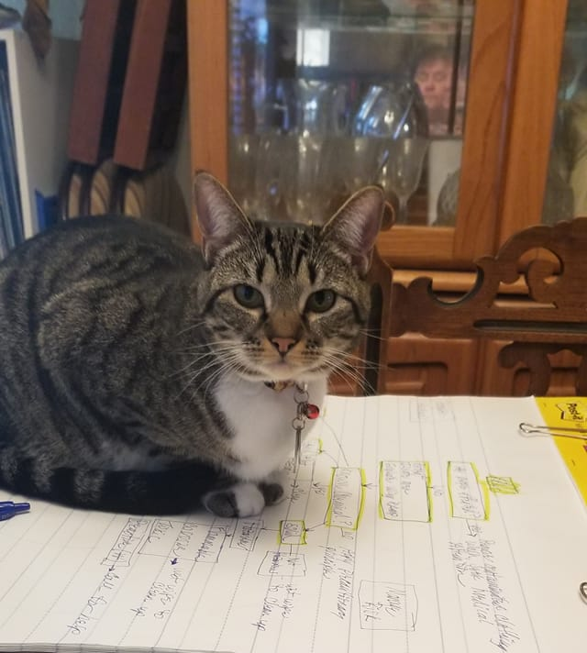
Questions?

