Slide 1

Department of Chemistry and Biochemistry
What is a Culture of Safety
and Can It Be Changed?
Dominick Casadonte
Texas Tech University
Department of Chemistry and Biochemistry
November 17th, 2020

Slide 2

Department of Chemistry and Biochemistry
Historical Concepts of Safety Culture:
Examples
International Atomic Energy Authority, 1991 (After Chernobyl):
“That assembly of characteristics and attitudes in organizations and individuals which establishes that, as an overriding priority, nuclear
plant (chemical) safety issues receive the attention
warranted by their significance”
UK Health and Safety Commission, 1993
“...The product of individual and group values, attitudes, competencies, and patterns of behavior that determine the commitment to, and the style and proficiency of, an organization’s health and safety programs. Organizations with a positive safety culture are characterized by communications founded on mutual trust, by shared perceptions of the importance of safety and by confidence in the efficacy of preventative measures.”

Slide 3
Department of Chemistry and Biochemistry
Historical Concepts of Safety Culture:
Examples
Health and Safety Executive, 2005
“The term safety culture can be used to refer to the behavioral aspects (i.e. ’what people do’), and the situational aspects of the company (i.e. ’what the organization has’)." "The term safety climate should be used to refer to psychological characteristics of employees (i.e. ’how people feel’) corresponding to the values, attitudes, and perceptions of employees with regard to safety within an organization.”
M.C. Noort et al., 2016
“Safety Culture refers to the norms, values, and practices shared by a group in relation to risk and safety.

Slide 4
Department of Chemistry and Biochemistry
Safety Culture vs Safety Climate
• Often the terms are used interchangeably, though they are not the same.
• Safety culture is part of the overall organizational culture
• Safety climate is a snapshot of the safety culture as defined by
employee attitudes and perceptions
• Psychologically similar to comparing mood (climate) to
personality (culture)

Slide 5

Department of Chemistry and Biochemistry
Academic and Industrial Safety Culture
Academia varies from industry in many
ways:
• The organization culture in industry is largely cohesive, while academia has a more segmented cultural structure.
• One research lab varies from the next due to the independent nature of each lab.
• The faculty who are in charge of the lab space determines how the lab is run
• EH&S and Administration provide guidelines
• The ability to hire and fire based on safety performance is, in most cases, limited,
due to the educational nature of the academy

Slide 6

Department of Chemistry and Biochemistry
The Nature of Safety Cultures
Safety cultures can be positive or negative, healthy or unhealthy, depending on their impact and influence
A healthy safety culture:
• minimizes the opportunity for accidents and near-misses
• characterized by open communication
• provide mechanisms designed for continual improvement
• provides for the efficacy of training and preventative measures.
• is associated with higher quality and reliable work
• generates higher commitment, loyalty, and increased job satisfaction

Slide 7
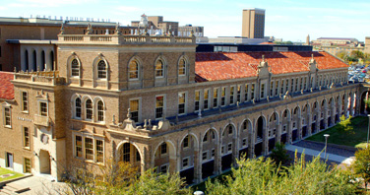
Department of Chemistry and Biochemistry
Texas Tech Chemistry:
• Buildings: Two (1928 (Renovated 1988); 1968-1971)
• Faculty: 30 (24 in 2010)
• Graduate Students: 105
• Postdoctoral Research Associates: 34
• Technical Staff: 9
• Clerical Staff: 10
• Chemistry Undergraduate Majors: 250
• Biochemistry Undergraduate Majors: 256
• Total Funding (2009): $5.2 M
- Federal Grants: $ 3 M
- Non-Federal Grants: $ 1.5 M
- Co-PI: $ 750 K
• Federal R&D Expenditures (2010):
- Top 100
- #83 (2015)

Slide 8
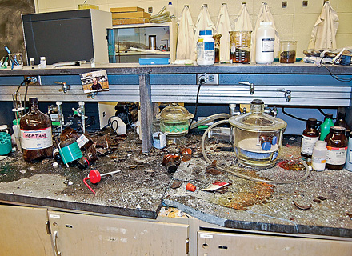
Department of Chemistry and Biochemistry
• January 7, 2010: Explosion in Energetic Materials Lab Injures Student

Slide 9
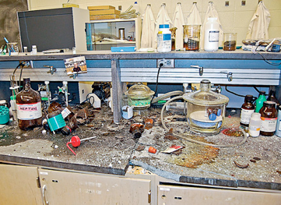
Department of Chemistry and Biochemistry
• January 7, 2010: Explosion in Energetic Materials Lab Injures Student
• Accident Picked Up
in National Media:
- C&EN, Jan. 25, page 7
- C&EN, Feb. 1, pages 25-26
- C&EN, July 23 (Online)
- C&EN, Aug. 23, pages 34-37

Slide 10
Department of Chemistry and Biochemistry
• January 7, 2010: Explosion in Energetic Materials Lab Injures Student
• January 8, 2010: Call from
National Chemical Safety Board
• Feb. 11: Lab Reopened
• Feb 26: DHS Visit (Northeastern)
• March 19-23: Visit by Chemical
Safety Board
• April 9: Internal Investigation Results Released
• May 25: DHS (ALERT) Visit
• October 15: Findings from the CBS Released

Slide 11
Department of Chemistry and Biochemistry
TTU: The CSB Report
Overall, investigations found a lack
of oversight regarding safety at all
levels of the university and the
CSB investigation team made
several recommendations to
address and correct these concerns

Slide 12
Department of Chemistry and Biochemistry
TTU: The CSB Report
• Adapt elements of physical risk into our chemical hygiene plan.
• Require Texas Tech University (TTU) to become an exemplary institution around the culture of safety.
• Require the University to report annually to the U.S. Chemical Safety Board about progress made toward improving the culture of laboratory safety; the parameters will need definition.
• Acquire an online chemical inventory system.
• Require the Provost and Vice President for Research to make laboratory safety an element of annual evaluations (e.g., college, department, faculty).
• Others to be determined.

Slide 13
Department of Chemistry and Biochemistry
Texas Tech Chemistry: Building the Culture
• EH&S Placed Under the Aegis of the
Vice President for Research
• Institutional Laboratory Safety
Committee (ILSC) Established to
develop campus safety culture

Slide 14
Department of Chemistry and Biochemistry
Texas Tech Chemistry: Building the Culture
• EH&S, ILSC, and Chemistry Safety
Committee Revamped Chemical
Hygiene Plan (now Work Area Safety
Plan (WASP)
- Completed 2013
- Updated Annually
- All researchers tested
(Students once a year; faculty once every two years)
• Safety Concerns and Near Misses (SCAN) system instituted

Slide 15
Department of Chemistry and Biochemistry
Texas Tech Chemistry: Building the Culture
• All Continuing Lab Researchers are
Required to Undergo Mandatory
Chemical (and other) Safety Training
(September): Verification in Personnel
File
- 100% Compliance since Spring 2012 +
• All New Lab Researchers are Required to Undergo Safety Training Before They Can Chose a Research Mentor: Verification in Personnel File
- 100% Compliance, Summer, 2012+

Slide 16
Department of Chemistry and Biochemistry
Texas Tech Chemistry: Building the Culture
• Group Codes of Conduct and Operating Procedures in Place, and Provided to and Signed by Students
• Failure to Comply with Policies and Protocols Results in Immediate Dismissal from the Laboratory
• Failure of research laboratories to comply with policies can result in lab shutdown until in compliance (no shutdowns since 2012)

Slide 17
Department of Chemistry and Biochemistry
Texas Tech Chemistry: We’re Still Working On It
• Working on Developing “Carrots”
for Superior Laboratory Safety
Activities: $25K Departmental
Safety Award, 2019
• CHEM 5104: Introduction to
Laboratory Safety and Responsible Conduct of Research
- Developed in Spring, 2015
- All New Graduate Students in Chem and Biochemistry
Required to Take It
•Safety/RCR Graduate Cumulative Exam 2012-2018

Slide 18
Department of Chemistry and Biochemistry
Texas Tech: The Journey Continues…
In July of 2015, the National Chemical Safety Board closed its investigation into the 2010 explosion at Texas Tech University. They indicated that they were satisfied with our actions and that we had gone above their expectations…

Slide 19
Department of Chemistry and Biochemistry
Texas Tech: The Journey Continues…
In 2016, we became more interested in what was going on around the country beyond UCLA and Texas Tech, and what, exactly, constitutes a safety culture...
Defining Academic Safety Culture: A National Study
Megan E. Gonzalez, Ph.D., 2019

Slide 20
Department of Chemistry and Biochemistry
The Study
• 92 Question Likert Scale and Free Response Questions
• 388 respondents from R-1 and R-2 Institutions
• 200 used for exploratory and 188 used for confirmatory
factor analysis
EFA CFA Total EFA CFA Total
Age Position
18-24 47 33 80 Grad Student 127 126 253
25-30 77 87 164 Faculty 35 27 62
31-40 23 26 49 PI/Advisor 17 13 30
41-50 17 12 29 Staff 9 5 14
51-60 9 12 21 EH&S 1 1 2
60+ 15 10 25 Postdoc 16 13 29

Slide 21
Department of Chemistry and Biochemistry
The Study
Outcomes
• Many of the factors determined to be significant in industrial safety culture
are applicable to academic safety culture, including:
Lessons learned Maintenance
Motivation and recognition Personal factors
Performance pressure (Efficiency
and results) Policies and procedures
Position factors Practices and behaviors
Priorities Reporting and review
Risk Safety
Social factors Training

Slide 22
Department of Chemistry and Biochemistry
The Study
Outcomes
• Many of the subfactors determined to be significant in industrial safety culture are applicable to academic safety culture, including:
Industrial Factors Academic Subfactors
Attitudes Attitudes
Communication Communication (within the lab,
with EH&S, within the department,
etc.)
Confidence in the system Confidence in the safety system
Departmental safety climate
EH&S/researcher relationship
Demographic influence Demographic influence
Ethics Ethics (Reporting at the risk of retaliation)
Involvement Involvement in safety related activities
(departmental and personal)

Slide 23
Department of Chemistry and Biochemistry
The Study
Outcomes
• “Management factors” did not translate well

Slide 24
Department of Chemistry and Biochemistry
An Evidence-Based Definition
of Safety Culture
General Safety Culture: “the shared values, beliefs, attitudes, social and technical practices, policies, and perceptions of individuals in an organization that influence the opportunity for accidents to occur.”
Academic Safety Culture: “the amalgamation of shared attitudes, beliefs, ethics, perceptions, and priorities of individuals within academic research labs that, when combined with departmental policies, procedures, and regulations, influence the opportunity for accidents to occur.”

Slide 25
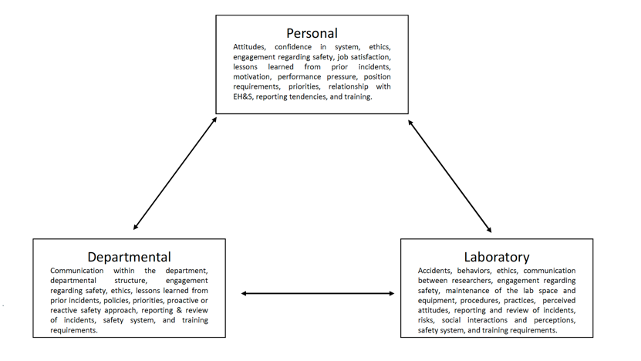
Department of Chemistry and Biochemistry
An Evidence-Based Definition
of Academic Safety Culture
Advisor
EH&S
Administration

Slide 26
Department of Chemistry and Biochemistry
Improving Academic Safety Culture
• Departments should provide a standardized training for lab safety officers/captains in order to ensure that individuals in these positions understand their responsibilities and can maintain lab safety appropriately and efficiently.
• Departments/laboratories should consider potential regional hazards such as the effects of the climate and inclement weather on the activities in lab when designing policies and facilities.
• Researchers and EH&S need to build a better rapport with the goal of working
together to improve safety without inhibiting research unnecessarily. Safety mandates should include documentation regarding why changes need to be made and EH&S should be available to help implement the changes properly.
• Social factors such as peer-to-peer interactions and perceived peer competence were repeated subfactors. Creating a student-led initiative can positively impact the safety culture through a grass-roots approach.

Slide 27
Department of Chemistry and Biochemistry
Improving Academic Safety Culture
• People in positions of authority can determine the attitudes, beliefs, and actions taken in regards to safety culture. The impact of this particular subfactor should not be underestimated. People in positions of authority should be encouraged to hold safety as a high priority. A healthy top-down approach to safety has a positive effect on the overall departmental safety culture.
• Institutions/departments should consider prioritizing maintenance of facilities before building new ones. Grants can be used to cover initial start up costs but rarely allow for maintenance.

Slide 28
Department of Chemistry and Biochemistry
Cultural Lessons Learned at Texas Tech
1) Accidents at Public Universities are Public Events
- Good Safety Doesn’t Make Headlines: Lack of Safety Does!
2) Chemistry Labs are Dynamic:
The Safety Culture Must Be Vigilant and Can No Longer
Be Complacent
3) Faculty: EH&S Relationship Has Changed at Texas Tech
- Communication is the Key!
- Not Everyone Has the Same Idea of What Constitutes
Safety in a Pluralistic Society: Dialogue Needed!

Slide 29
Department of Chemistry and Biochemistry
Cultural Lessons Learned at Texas Tech
4) A Stick is More Effective than a Carrot to Start
- Consequences for Lack of Safety Need to Be In Place
5) But we need carrots to thrive!
6) Faculty Under Increasing Pressure to Get Results: Building a safety culture into this reality is vital
7) Computerization of MSD and CHP Can Lead to Complacency

Slide 30
Department of Chemistry and Biochemistry
Cultural Lessons Learned at Texas Tech
7) A Survey of the Current State of Academic Safety Practices
Needs to be Shared with the Community
8) We Need More Safety Videos, etc.
9) We Need Specific Protocols for Specific Lab Procedures
In a Common Database
10) We Need Templates for Common Safety Paperwork
11) We Need Active Participation by Industry and the Government

Slide 31
Department of Chemistry and Biochemistry
Cultural Lessons Learned at Texas Tech
12) The University, College, Department, Faculty, Staff, Students
Must All Work Together for the Culture to Change:
Safety Really is EVERYONE’S Responsibility
13) It Saves Time and Resources to be Safe!
Safety Costs Money, but Saves Money (and Lives)
14) The Culture IS Changing Through the Younger Generation
of Scientists
15) The “Nothing Ever Happened to Me” Mentality of
Safety Must Be Challenged and Changed.

Slide 32

TEXAS TECH UNIVERSITYTM

