Slide 1
Options for “Laboratory” Learning
Face to Face (f2f)
Hybrid Delivery
Videotape Viewing (w/ Comp. Gen. Data)
Home Kits
Simulations
Kitchen Chemistry

Slide 2

Kits
eScience Labs (Lab Kits)
Hands-On Labs or HOL (Lab Kits)
Kemtec Science (Lab Kits for K-12)
Smart Science (Blended Labs)
Quality Science Labs (Lab Kits)

Slide 3
Kit Concerns
Waste disposal
Lab chemicals in home environment (kitchen)
Siblings gaining access
Downstream sale
Cost
PPE usage
Lead time
Liability

Slide 4
About HOL from 2009
With Hands-On Labs, the institutions are its clients but the students themselves are its customers, and they buy kits directly from the company at an average cost of $179. In this way, the company -- and not the institution -- is liable in the event of a student’s accidental injury because of an experiment gone wrong. The kits provide enough chemicals and other materials for “micro-scale” reactions and experiments. On average, Jeschofnig said, the kits contain about 2.5 milliliters of chemicals, an amount she insists is “not enough to do anything nefarious.”
To the comfort of her clients, Jeschofnig asserts that, in 15 years of business, the company has not had a single claim filed against it. Still, she did note that it has a $3 million liability insurance policy just in case.
“The liability is ours, and we’re happy to accept it because we believe we have a safe product,” Jeschofnig said. “Also, a lot of schools don’t stock labs anymore. The cost of building them and maintaining them is too much. These are big things for a lot of schools and can help them save money.”
https://www.insidehighered.com/news/2009/06/05/home-dissection-kits-and-more

Slide 5
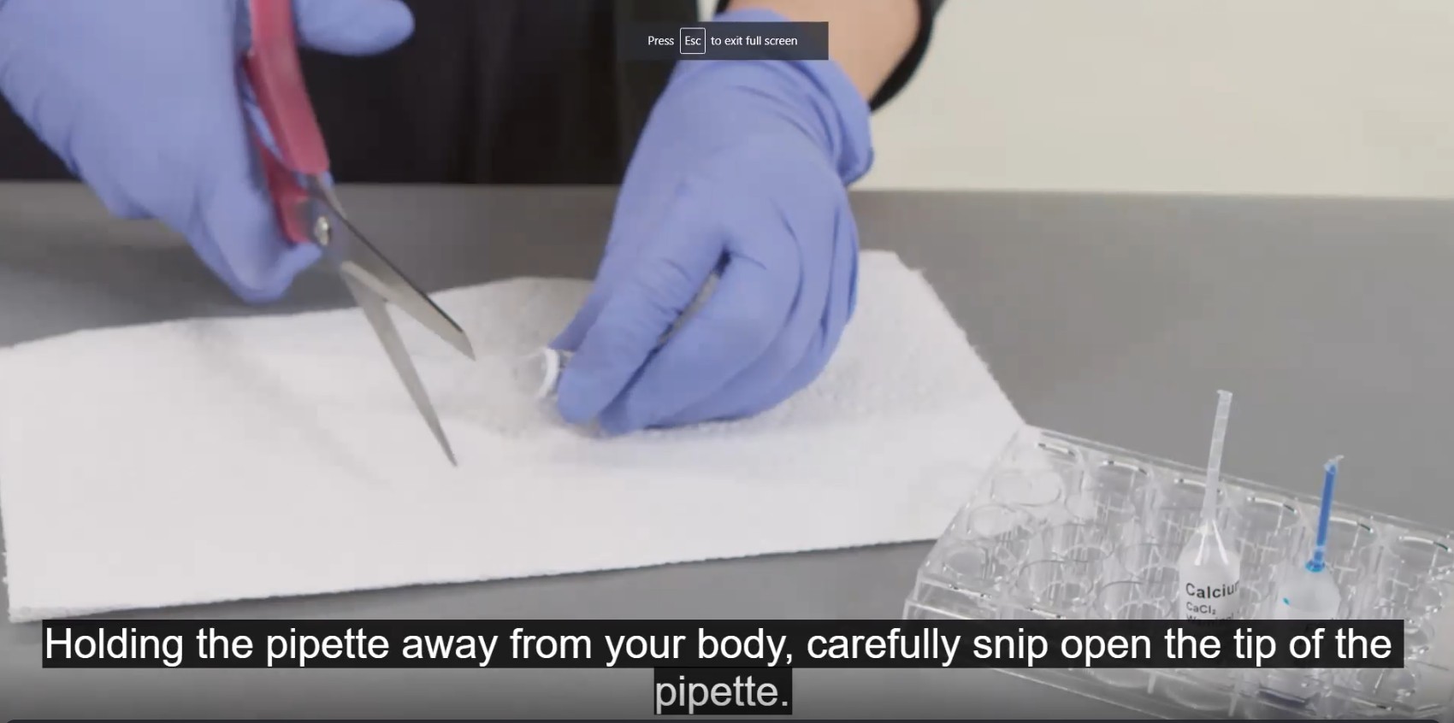
While the video shows wiping off the pipets in between samples, there is no mention of using scissors that would never be used in the kitchen or even washing them after use.
Notes:
I have attended one of the kit company webinars and they only wanted to sell their learning platform for data analysis at $29 per student/per course. I was very unimpressed with their answers to my questions. By the way, this is the same company that wants the students to lock the doors to the rooms where they are working.

Slide 6
Simulation Options
The Chemistry Collective (Free)
Publisher Supported

Slide 7
Rotating Student Groups
Some components of the course are offered virtually and some in person
Different groups of students rotate “through” the face-to-face classroom on different class days. For example, half (TR) or one-third (MWF) of students attend
face-to-face class once a week while others engage in activities online
All face-to-face classes and online activities given in one week are the same so students have comparable experiences
Notes:
So for example, we will have an introduction to GHS exercise that students complete.

Slide 8

This is not an endorsement, just an example of one of many available. We selected this one based on:
Previous experience with the company
Available simulations offered
Cost for the student reasonable
Instructor support
Integration with our LMS
https://courses.hayden-mcneil.com/course/view.php?id=974

Slide 9
Virtual Concerns
Possibly created outside US which could impact regulations
Student frustration levels might be high
No hands-on experience

Slide 10
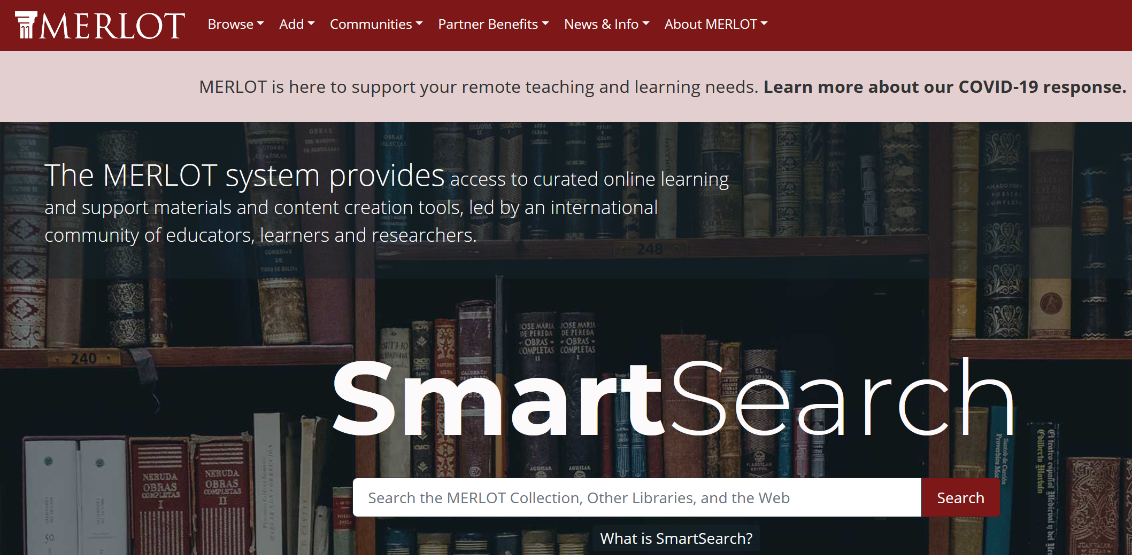
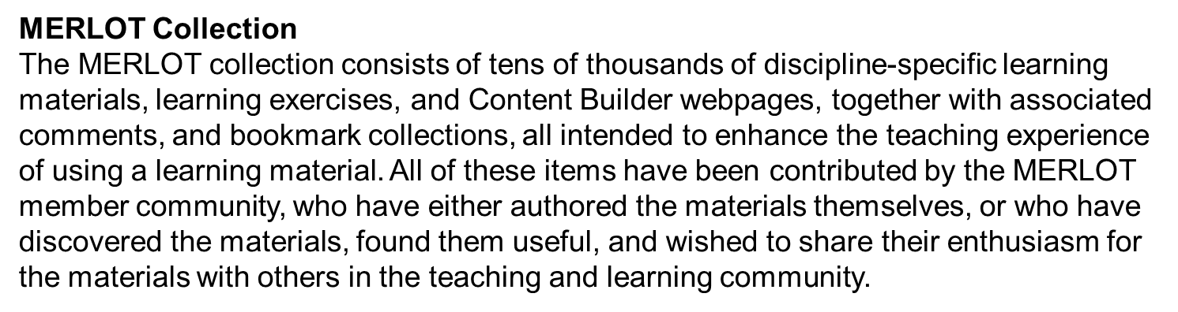
https://info.merlot.org/merlothelp/topic.htm#t=MERLOT_Collection.htm

Slide 11
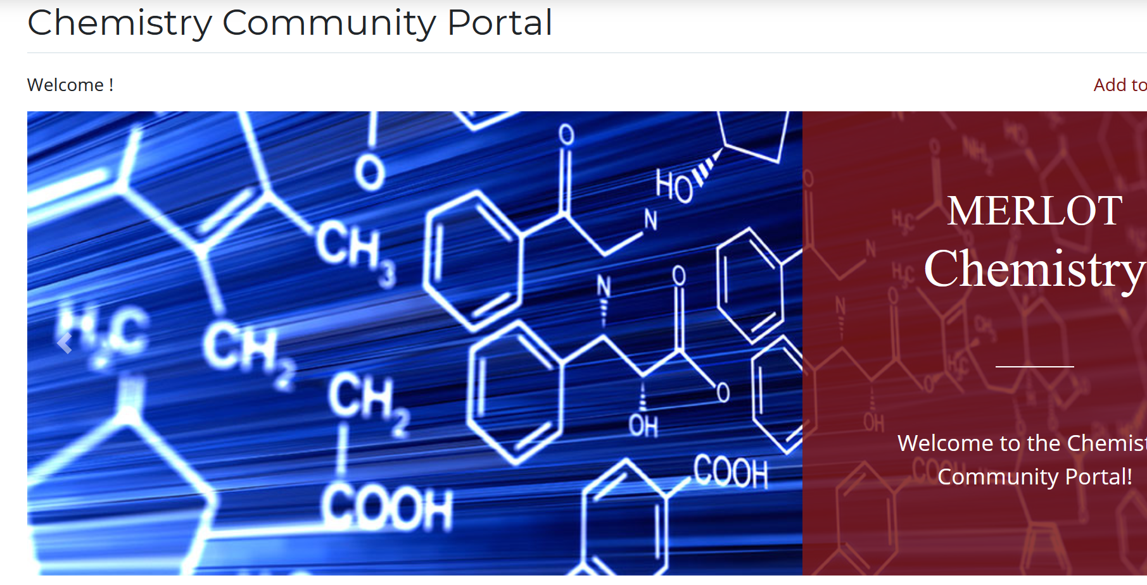
https://info.merlot.org/merlothelp/topic.htm#t=MERLOT_Collection.htm

Slide 12
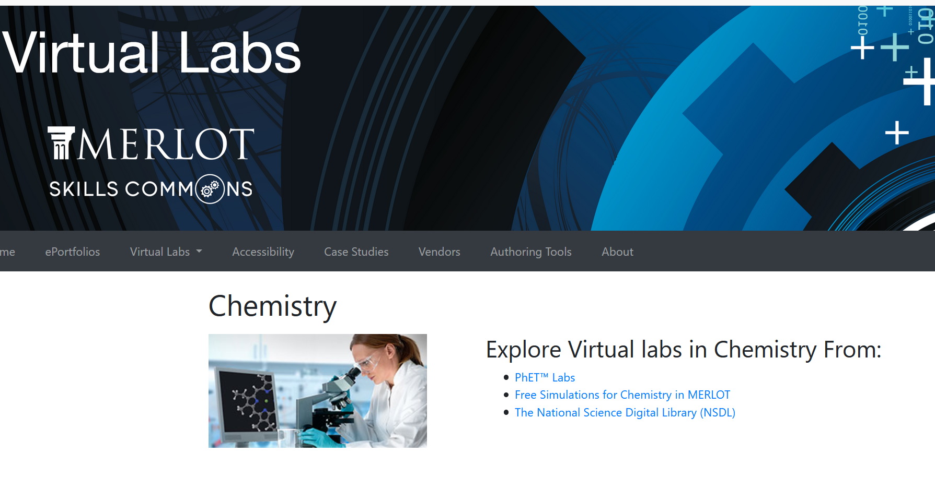
Physics Education Technology
https://virtuallabs.merlot.org/vl_chemistry.html

Slide 13
Additional Resources
LeighAnn Tomaswick's compilation of online simulations, labs, and other instructional resources.
POD (the society for Centers for Teaching and Learning) has promising practices and resources for moving courses online: https://docs.google.com/document/d/1pVMh1qsjHuHIODqPsXkB7i-aXoSUsilj8H4UztM9xAo/edit#
The Society for the Advancement of Biology Education Research (SABER) has a discussion board with resources and ideas for biology faculty: https://saberbio.wildapricot.org/Discussion-board/8824866
PhysPort has expert recommendation on physics/astro-specific advice and resources: https://www.physport.org/recommendations/Entry.cfm?ID=119906
Ecology/Environmental Science online learning resources: https://docs.google.com/spreadsheets/d/16K6bGTf-wGjxxi6aGi_v6vlLQSpsOgl1zq3tXLHWweg/edit#gid=0
Geoscience Materials for Teaching Online: https://docs.google.com/spreadsheets/d/1-R6THvCIcAjGrWRspCN915SIzItdZ95ziwiF8BmQrYc/edit#gid=0
The American Astronomical Society (AAS) curated online teaching resource: https://docs.google.com/document/d/1UPZVyq2U7GTC5I7R1TI_rsRDwu4FXt9aukGYXIeq60Q/edit?ts=5e6a9f6a
Resources for teaching inclusively from the Aspire Alliance: https://www.aspirealliance.org/national-change/covid-19-resources
Clinical experiences for teacher ed programs: https://www.margaretmohrschroeder.com/?page_id=1363
How to Quickly (and Safely) Move a Lab Course Online (Chronicle of Higher Education)

Slide 14
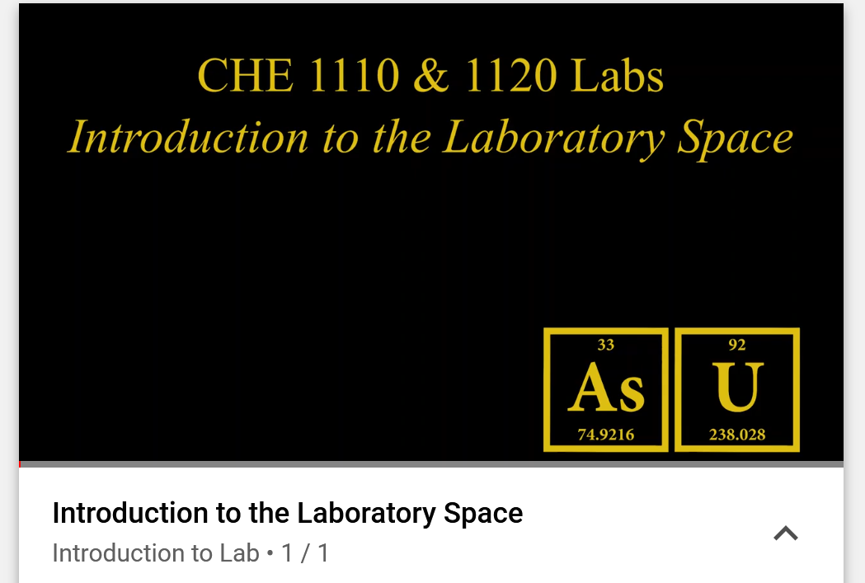
I thought that it was important to explain to students (and faculty) why laboratories are unique spaces.
Intro to Lab Spaces

