Slide 1
An unknowing, unthinking, uncaring graduate student learns a lesson about safety
Robert H. Hill, Jr.
Stone Mountain, GA

Slide 2
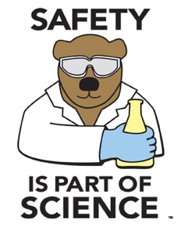
Undergraduates need a safety education!¹
Graduates:
  Lack safety knowledge/understanding
  Lack safety ethics (caring/thinking)
  Don’t know that they don’t know
Academic institutions:
  Left safety education out of curriculum
  Substituted safety training for safety education
    Safety education and safety training are NOT equivalent
¹RH Hill, J Chem Ed 93 1495-1498 (2016)

Slide 3
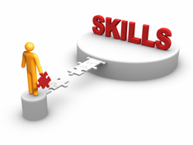
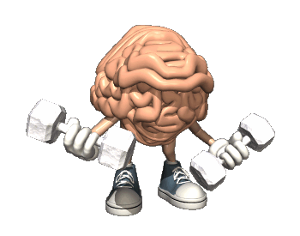

Undergraduates need a safety education!
Education
Training
Mind building
Thought building, critical thinking
Principles, general applications
Long-term learning
Taught by educators
Provides basic knowledge, understanding for future careers
Skill building
Behavior, rules
Specific applications
Short-term learning
Provided by employers
Specific required skills, knowledge to do jobs

Slide 4
Undergraduates need a safety education!
Safety education provides two things:
  Knowledge, understanding (critical thinking) to handle future safety issues, AND
  Caring/thinking about safety (ethics) with safety teaching throughout curriculum
Find ways to fold principle-based safety education into curriculum
Teach safety in all lab-based sciences
THE SAFETY ETHIC: I value safety, work safely, teach safety, prevent at-risk behavior, promote safety, and accept responsibility for safety.
RH Hill, J Chem Health Safety, 20 8-11 (2003)

Slide 5
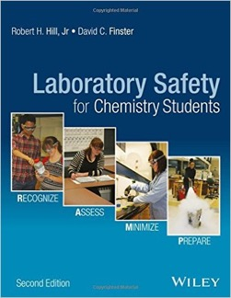
R.A.M.P Up for Safety
Four Principles of Safety
  Recognize hazards
  Assess risks of hazards
  Minimize risks of hazards
  Prepare for emergencies
safetY
R.A.M.P.
up for
R Hill, D Finster. Laboratory Safety for Chemistry Students, 2nd Edition, John Wiley & Sons, Hoboken, NJ, 2016

Slide 6
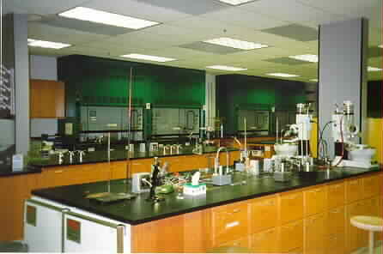
Once upon a time in a lab where chemistry happened……
Graduate student (2nd yr) – synthetic organic research
Lab/teaching assistant (undergraduate & graduate)
Safety instruction
  Yearly 1-hr review of Dept. safety rules
  PI’s safety reminder – “Be careful!”
Did not know that he did not know about safety

Slide 7
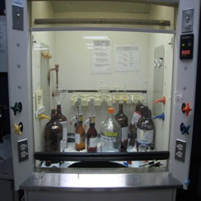
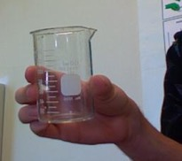
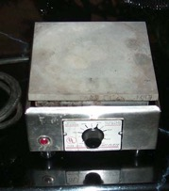
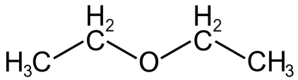
The incident
Needed to purify a solid synthesis product
Laboratory hood – too cluttered for use
In a hurry, did not want to clean up hood
Recrystallization in beaker on open bench using hot plate
Began heating product in solvent - diethyl ether

Slide 8
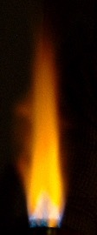
The incident
Solvent (ether) began to boil on hot plate
Then he heard the THUNDEROUS CLICK!
Instantly a flash fire ran up his right arm, burning hair off arm, eyebrows
He staggered backwards in shock
Only then did he realize that he had not recapped the 5-gal can of ether
It looked like a giant Bunsen burner with a flame about 12 inches high
Another graduate student extinguished the fire

Slide 9
using ramp to analyze incident
Recognize hazards – not done (Hazard is potential source of danger or harm)
  Housekeeping
  Cutting corners – hurried, lazy?
  Flammable on open bench
  Hot plate – not spark proof
  Carelessness – Failed to recap ether
  Not thinking/caring about safety
Assess risks of hazards – not done
Minimize risks of hazards – not done
Prepare for emergencies – not done

Slide 10
Why did this happen?
Hot plate ignited flammable vapors on open bench – Did not understand properties of flammable chemicals
Cut corners – Poor housekeeping in hood; in a hurry or too lazy to clean up hood
Did not recognize and understand multiple hazards
Did not receive a laboratory safety education AND did not think about safety (missing safety ethic)
Safety education missing from chemistry curriculum
WHY?
WHY?
WHY?
WHY?
WHY?

Slide 11
Teaching The “r” of ramp
Recognizing and understanding hazards
  Critical for safe chemistry
  Doesn’t just “happen” – needs to be taught
  Learning about hazards builds strong safety ethic (caring/thinking about safety)
  Without “R”, RAMP does not work
Assessing, Minimizing, Preparing must be taught
Integrate Safety Education into undergraduate/graduate educational processes
Recognize hazards
Assess risks of hazards
Minimize risks of hazards
Prepare for emergencies
safety
R.A.M.P.
up for

